Slide 1

Object Oriented Design
  Transition to design
  Attribute specification and identifying operations
  Design models

Slide 2
Introduction to OOD
What is OOD?
It's the process of transforming analysis models into a detailed blueprint for software implementation.
  It's not just about writing code; it's about crafting a blueprint for robust, scalable software.
  It transforms abstract ideas (analysis models) into concrete structures ready for development.
Core Principles:
OOD emphasizes the use of objects, classes, encapsulation, inheritance, and polymorphism to structure a system.
Why is it important?
It focuses on defining the system's structure and behavior to efficiently meet user requirements.

Slide 3
Why OOD Matters?
  Modularity: Breaking complex systems into manageable pieces.
  Reusability: Building components that can be used again and again.
  Maintainability: Making systems easier to understand, debug, and enhance.
  Key Pillars: Objects, Classes, Encapsulation, Inheritance, Polymorphism.

Slide 4
The Design Transition - Bridging the Gap
From Analysis to Design:
This phase refines the abstract analysis model into a concrete design ready for coding.
  we refine our understanding of what the system should do (analysis) into how it will be built (design).
Key Activities:
Defining detailed architecture and class structures.
Identifying system components.
Applying established design principles.
Choosing appropriate design patterns.
Think of it: Like an architect drawing detailed plans after understanding the client's needs.

Slide 5
Techniques & Tools for Design Transition
Techniques:
Use case-driven design:
Designing based on how users interact with the system.
Modular and layered architecture:
Breaking down the system into manageable, independent parts.
Design pattern selection:
Reusing proven solutions to common design problems.
Tools:
UML tools: StarUML, Lucidchart (for creating visual diagrams).
CASE tools: Computer-Aided Software Engineering tools.
IDEs with modeling plugins: Intellij, Eclipse (integrating design directly into development environments).

Slide 6
Attribute Specification - What Does an Object Know?
Attributes: These are the data points, the characteristics, the "nouns" that describe an object's state.
Key Considerations for Attributes:
Name: What is this piece of data called? Clear, descriptive name.
Data Type: What kind of data is it (e.g., String, Integer, Boolean)?
Default Value: What is its initial value, if any?
Visibility: Who can access this data? (private, public, protected).
  private (-): Accessible only within the class (good for encapsulation!).
  public (+): Accessible from anywhere
  protected (#): Accessible within the class and by subclasses.
Constraints and Validations:
  Are there any rules for its values? (e.g., age must be > 0).
Representation:
Attributes are clearly represented using UML class diagrams.

Slide 7
Identifying Operations - What Can an Object Do?
Defining Behavior: Operations represent the actions or behaviors that objects can perform. "verbs"
Sources for Identifying Operations:
Use Cases: What actions are needed to fulfill user interactions?
Responsibilities : What responsibilities does an object have,
Interactions: How does this object communicate with others
Business Rules: What specific actions are dictated by the business logic?

Slide 8
Identifying Operations - What Can an Object Do? (CONT.)
Categorizing Methods:
Accessors (Getters): Retrieve attribute values.
getName(), getId()
Mutators (Setters): Modify attribute values. setName(newName), setId(newId)
Utilities: Perform other internal or helper functions.
calculateTax(), processOrder()
Documentation: Use CRC cards (Class-Responsibility-Collaboration) or class diagrams.

Slide 9
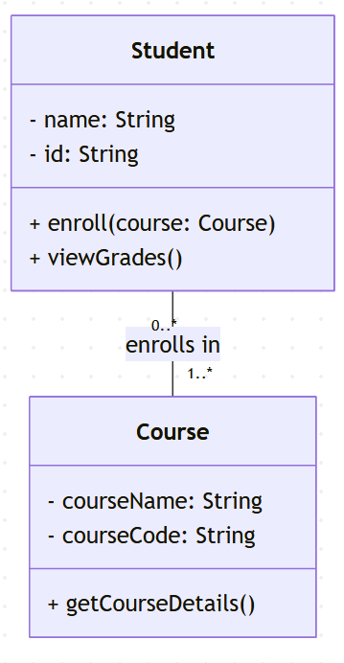
Example Class Diagram - The "Student" Example
The Student class has name and id (private data). It can enroll() in a Course and viewGrades().
There's a relationship: a Student can enroll in multiple Courses, and a Course can have multiple Students.
Clarity:
It provides a clear visual representation of a class's structure.

Slide 10
Design Model Overview
Your System's Storybook
A Collection of Diagrams: The design model is a set of diagrams that detail the system's structure and behavior.
Diagram types:
Class Diagrams: Illustrate the static structure of the system (classes, attributes, relationships).
Sequence Diagrams: Show the dynamic interaction flow between objects over time.
State Diagrams: Describe the lifecycle of an object and its different states.
Component Diagrams: Represent the physical structure and dependencies of software components.
Goal: To ensure every requirement from the analysis phase is clearly addressed in the design.

Slide 11
Design Model Techniques & Tools
Techniques for Building the Design Model:
Top-down design:
  Starting with the high-level system and breaking it down into smaller components.
Bottom-up design:
  Starting with individual components and integrating them to form the system.
Responsibility-driven design:
  Assigning clear responsibilities to each class.
Tools for Modeling:
UML modeling tools: Lucidchart, StarUML (for creating various UML diagrams).
Development environments: Visual Studio (often include integrated modeling capabilities)

Slide 12
Example Sequence Diagram - Illustrating Dynamic Interactions
The dynamic interaction between objects over time, showing the order of method calls.
Understanding Flow:
This diagram visually illustrates the dynamic interaction and message flow between different objects.
Example:
A sequence diagram could show how a "Student" object interacts with a "CourseCatalog" object to enroll in a "Course."
Key Insight:
It demonstrates the order of method calls and the flow of data between objects.

Slide 13
Example: Student Enrollment Process
Student asks CourseCatalog to findCourse("CS101").
CourseCatalog returns Course object.
Student asks Course to checkAvailability().
Course checks its capacity.
Course asks EnrollmentService to enrollStudent(student, course).
EnrollmentService updates records.
Value: Helps visualize potential bottlenecks, understand data flow, and debug interaction issues.

Slide 14
Component Diagram Overview - The Physical Architecture ie The System's Physical Layout
Deployment Structure:
Describes the physical deployment structure of the software.
This diagram describes how the different software components are physically deployed and interact.
Components & Dependencies:
Shows the different software components (e.g., "Web Server," "Database," "Payment Gateway Service") and how they depend on each other.
Integration & Deployment:
Extremely useful for planning how different parts of the system will integrate (how different parts fit together) and be deployed.
Crucisl for :
Understanding deployment requirements (what needs to be installed where).
Identifying potential scalability or infrastructure challenges.

Slide 15
Summary
Bridge to Implementation:
OOD serves as the crucial bridge between initial analysis and actual software implementation.
Defining System Elements:
It defines both the static structure (attributes, classes) and the dynamic behavior (operations, interactions) of a system.
Clarity and Planning:
OOD leverages various diagrams and tools to ensure clarity, thorough planning, and effective communication throughout the development process.

Slide 16
Student Course Registration System
System Overview - Student Course Registration
The Goal: Design a system that allows students to register for courses, view their schedules, and manage their academic records.
Key Actors:
  Student: The primary user of the system.
  Administrator/Registrar: Manages courses, students, and registration periods.
Core Functionality:
  Browse available courses.
  Register for courses.
  View current schedule and registered courses.
  Withdraw from courses.
  (Optional) View grades.

Slide 17
Identifying Core Objects (Classes)
Based on our system overview, what are the key "things" or "concepts" that will have data and behavior?
Student: Represents a student enrolled in the university.
Course: Represents a specific course offered by the university.
Registration: Represents the act of a student enrolling in a course.
CourseCatalog: A collection of all available courses.
EnrollmentService: Handles the logic for student registration and withdrawal.
Grade: (If we extend to grades) Represents a student's grade in a course.

Slide 18
Class Design: The 'Student' Class (Attributes & Operations)
Student class.
Attributes (Data it holds):
studentID: String (private, unique identifier)
name: String (private, full name)
major: String (private, student's major)
email: String (private, contact email)
enrolledCourses: List<Course> (private, a list of courses the student is currently registered for)
gpa: double (private, student's cumulative GPA, if applicable)

Slide 19
Operations (Actions it can perform or respond to):
+ login(username, password): boolean (Allows the student to log in)
+ viewAvailableCourses(): List<Course> (Requests a list of available courses from the system)
+ registerForCourse(courseID): boolean (Requests to register for a specific course)
+ withdrawFromCourse(courseID): boolean (Requests to withdraw from a course)
+ viewMySchedule(): List<Course> (Shows the student's current registered courses)
+ updateProfile(newEmail, newMajor): void (Allows student to update their details) (Actions it can perform or respond to):

Slide 20
Class Design: The 'Course' Class (Attributes & Operations)
Attributes (Data it holds):
- courseID: String (private, unique course identifier)
- title: String (private, course name)- description: String (private, detailed course description)
- credits: int (private, number of credits for the course)
- capacity: int (private, maximum number of students allowed)
- currentEnrollment: int (private, current number of students enrolled)- professor: String (private, instructor's name)
- prerequisiteCourses: List<Course> (private, list of courses required before taking this one)

Slide 21
Operations (Actions it can perform or respond to):
+ getCourseDetails(): String (Returns all relevant course information)
+ isAvailable(): boolean (Checks if there are open spots)
+ addStudent(): void (Increments current enrollment - called by EnrollmentService)
+ removeStudent(): void (Decrements current enrollment - called by EnrollmentService)
+ checkPrerequisites(student): boolean (Verifies if student meets prerequisites)

Slide 22
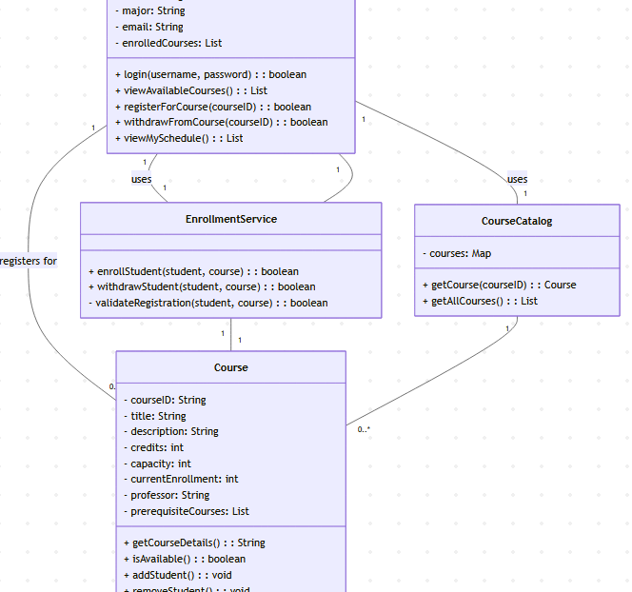
UML Class Diagram: Static Structure
Student registers for many Courses.
Student uses EnrollmentService to register.
Student uses CourseCatalog to view courses.
EnrollmentService interacts with both Student and Course to manage enrollment.
CourseCatalog manages a collection of Courses.

Slide 23
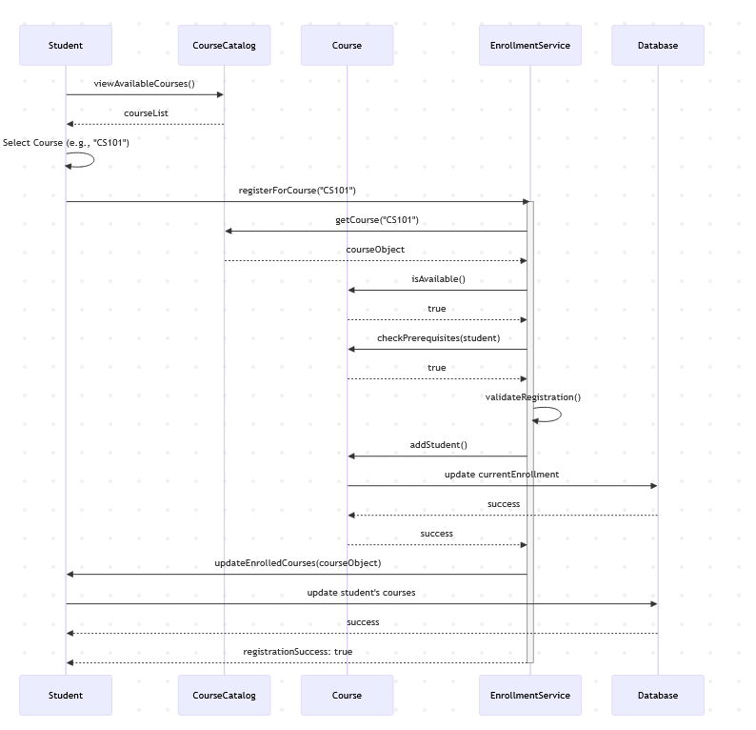
Sequence Diagram: Registering for a course
Notes:
Walkthrough:
Student asks CourseCatalog for available courses.
CourseCatalog returns the list.
Student selects a course and requests EnrollmentService to register.
EnrollmentService fetches course details from CourseCatalog.
EnrollmentService checks if the Course is available and if the Student meets prerequisites.
If all checks pass, EnrollmentService tells the Course to addStudent(), which updates its enrollment count in the Database.
EnrollmentService then updates the Student's list of enrolled courses in the Database.
Finally, EnrollmentService confirms success to the Student.

